Slide 1


Audiometric Techniques and Considerations
Tri-Service Hearing Technician
4.2 Certification Course

Slide 2
Audiometric Techniques and Considerations
Learning Objectives
2.3.1 Complete a comprehensive aural history
2.3.2 Understand the benefit of an otoscopic examination and when to do one
2.3.3 Explain the considerations for patient testing and preparation for testing
2.3.4 Explain the standard process of air conduction threshold testing, for automatic and manual methods
2.3.5 Understand factors affecting test validity
Tri-Service Hearing Technician 4.2 Certification Course

Slide 3
Audiometric Techniques and Considerations
Who May Perform Audiometry
OSHA
  Licensed audiologist, otolaryngologist or physician
  OHCs certified by CAOHC or who have “demonstrated competence”
  Technician who demonstrates competence operating a microprocessor (does not need to be certified)
NIOSH and DoD do not recommend “demonstrated competence” option
DoD requires Military hearing technician certification training and/or CAOHC certification
  This applies to contract and sub-contract technicians
Individual states may also require certification
Tri-Service Hearing Technician 4.2 Certification Course
Notes:
USN does not recognize on-line course or CAOHC without further DOEHRS-HC training

Slide 4
Audiometric Techniques and Considerations
Audiometric Procedures
Equipment Pre-checks
  Daily functional listening check
  Daily calibration
Obtain aural (hearing) history
  Demographic data form
Perform otoscopic examination
Place subject in audiometric booth
Provide clear, understandable instructions
Place earphones on subject
  Red on right / Blue on left
Tri-Service Hearing Technician 4.2 Certification Course

Slide 5
Audiometric Techniques and Considerations
Audiometric Procedures
Complete test IAW ANSI
Accurately enter patient demographic data while patients are testing
Select correct test type
Retrieve/record audiometric results
Review audiogram for potential problems
Counsel employee, educate, and arrange follow-up tests if needed
Refer as needed
Tri-Service Hearing Technician 4.2 Certification Course

Slide 6
Audiometric Techniques and Considerations
Prepare for Testing
Ensure ambient noise levels in the test environment are below standards outlined in applicable regulations
Log into the audiometric software application (DOEHRS-HC)
  Ensure equipment works properly
  Annual electro-acoustical calibration is valid
  Daily functional check is successful
  Daily biological calibration test is successful
Clean equipment IAW clinic infection control policies
Tri-Service Hearing Technician 4.2 Certification Course

Slide 7
Audiometric Techniques and Considerations
Infection Control
Follow local infection control guidelines
Include hand hygiene and equipment cleaning
Include plan for cleaning blood and/or other body fluids
Disposable earphone covers recommended
Non-alcohol based disinfection wipes - preferred method
Hand Switch/Earphone cleaning
  Do not use alcohol or harsh chemicals
  Keep moisture away from earphone diaphragm
  Ensure earphones are dry before patient use
Tri-Service Hearing Technician 4.2 Certification Course

Slide 8

Audiometric Techniques and Considerations
Aural History
Current auditory complaints
Changes in health, medications
Occupational and non-occupational noise exposure
Hearing protection use
Tinnitus
GINA – Genetic Information Nondiscrimination Act
  Do not ask family history questions
Tri-Service Hearing Technician 4.2 Certification Course Video Next Slide

Slide 9

Notes:
6 minute video – introduction to otoscopic examination

Slide 10
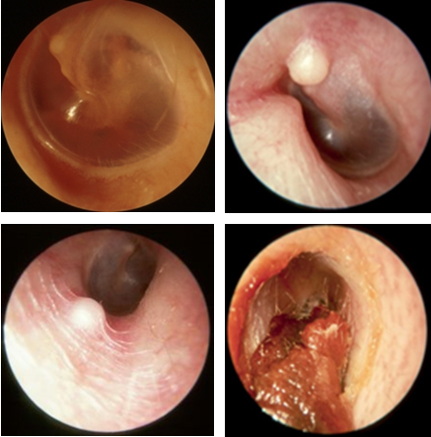
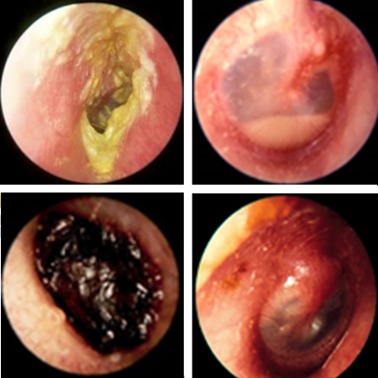
Audiometric Techniques and Considerations
Learning Objectives
Test Refer
Tri-Service Hearing Technician 4.2 Certification Course Video Next Slide
Notes:
Always do an otoscopic examination if conductive issues are suspected; if you are going to insert hearing protection into the ear canal; as soon as an STS is identified

Slide 11

Audiometric Techniques and Considerations
Otoscopic Video
Tri-Service Hearing Technician 4.2 Certification Course Video Next Slide
Notes:
30 second video, otoscopic exam, no vocals, describe what is occurring

Slide 12
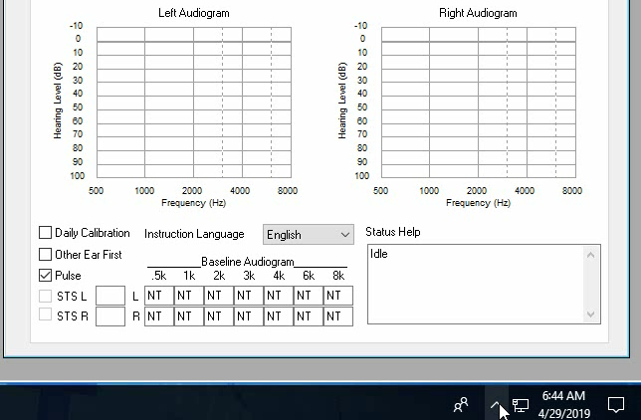
Audiometric Techniques and Considerations
Adjust Instruction Volume Prior to Patient Testing
Notes:
1 minute video – no vocals
Adjust instructions volume prior to patient testing
Have students put on the headphones and adjust volume

Slide 13
Audiometric Techniques and Considerations
Patient Processing/Instructions
Collect demographic forms, annotate station and ensure patient is in the correct station
Verbal instructions:
  Remove any foreign items in their mouth (gum, etc.)
  Remove eye glasses, hearing aids, large earrings, etc.
  Turn off all electronic devices
  Move hair away from ears
  Response switch in hand
  Test instructions will begin when the door shuts
  Place headphones on properly, red/right, blue/left
Tri-Service Hearing Technician 4.2 Certification Course
Notes:
Write station # on demographic form as you are placing the patients in the booth
Instructions can be modified to listener’s primary language within the CCA-200 software
ANSI S3.21-2004 - instructions shall be phrased in language appropriate to the test subject

Slide 14
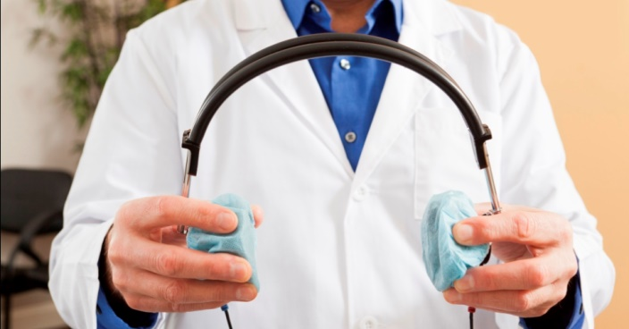
Audiometric Techniques and Considerations
CCA-200 Application Start Test Recorded Instructions
This is a hearing check. You will be listening for some tones. When you hear a tone, press the button once and quickly release the button. No matter how faint the tone, press the button when you hear a tone and quickly release the button. Upon completion of your hearing check, please remain seated and quiet until the operator releases you.
Tri-Service Hearing Technician 4.2 Certification Course
Notes:
Close audio booth door, start test booth; if auto voice instructions are not played, verbal instructions similar to above will need to be review with patients. Have students listen to instructions, adjust volume if needed to an appropriate level for patients with/without normal hearing.

Slide 15

Audiometric Techniques and Considerations
Audiometer Test Configuration
Pulsed stimuli is selected/used
  Helpful for patients with tinnitus
CCA-200 always begins with the left ear; changing to begin on the right ear is available (prior to test start)
  Test better ear first
  Testing better ear first allows patient to learn what to expect
  May be longer periods of silence during testing of poorer ear
Start/Error voice instructions are presented
Tri-Service Hearing Technician 4.2 Certification Course
Notes:
Inform students how to start test on the right ear

Slide 16
Audiometric Techniques and Considerations
Hearing Threshold Level (HTL)
Automated or Manual Testing
Hearing threshold at a frequency is defined as the lowest level at which a response occurs in at least half (50%) of the ascending stimuli
HTL is a statistical measure…not an absolute number
Variations of +/- 5 dB are not statistically significant
A hearing level to which the subject responds to 100% of the time would likely be at least 5 dB above the HTL
Tri-Service Hearing Technician 4.2 Certification Course

Slide 17
Audiometric Techniques and Considerations
Manual Testing Modes
Pulsed method presents 1-2 second tones
To determine a threshold present a 30 dB tone for the ear and frequency; if no response is recorded, increase stimulus level initially by 20dB then 10 dB until a response is obtained
After the initial response is validated, follow the threshold bracketing procedure
    Response - stimuli presentation decrease by 10 dB
    No response - stimuli presentation increased by 5 dB
    A threshold is determined when the patient responds twice in an ascending mode at the same intensity
CCA-200 semi-automatic manual mode will do the bracketing method automatically
Tri-Service Hearing Technician 4.2 Certification Course
Notes:
Initial Response Confirmation may be selected: stimulus to which the subject first responds in an ascending trial of a threshold determination is repeated. If the subject responds to the repeated stimulus, the test continues normally; otherwise, the stimulus intensity increases by 5 dB until the subject responds again. That response is again validated.

Slide 18
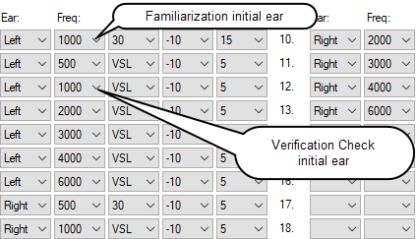
Audiometric Techniques and Considerations
Audiometric Test Sequence Automated/Manual
Initial stimuli presented at 30 dB, (per ear)
Repeat 1000 Hz (initial ear)
Retest within +/- 5 dB, records the lower threshold
If repeat varies by 10 dB or more, receives error message (RN) “retest not valid” reinstructs and continues testing (semi-automatic manual mode)
Continue with additional frequencies
Tri-Service Hearing Technician 4.2 Certification Course
Notes:
If conducting a complete “manually tested” audiogram, conduct test sequence for manual testing in the same frequency order as identified above

Slide 19
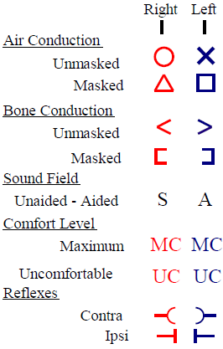
Audiometric Techniques and Considerations
Manual Testing
Consider manual testing if:
  Patient is having problems testing (error codes)
  Results differ greatly from the last test (STS, EWS)
  Questionable results
Evaluation legend
When using the CCA-200 semi-automatic manual testing mode, do not adjust the decibel level once a patient responds, application will keep track of the responses/stimuli presented and lock in thresholds once the patient responds twice in an ascending manner
Tri-Service Hearing Technician 4.2 Certification Course Video Next Slide
Notes:
Ensure to identify what Air Conduction X (Left) and O (Right) stand for when testing

Slide 20
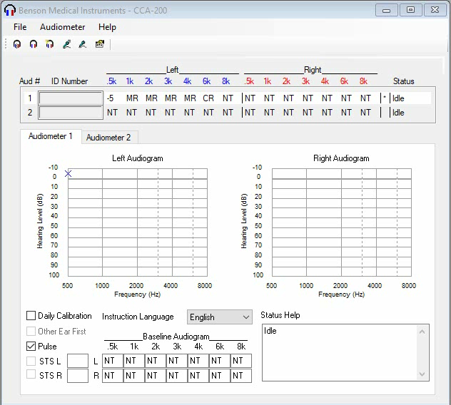
Notes:
2 minute video, manual testing; no vocals, describe what is happening; Video of locking in thresholds and also some of the reasons why a tech may want to perform manual testing.
Defaults to left ear, 1000 Hz, 30 dB; select ear/frequency; set NT if thresholds are already present; present stimulus; increase by 20 dB then by 10 dB until patient responds, do not adjust dials once the patient responds when using the semi-automatic manual testing mode. Bracketing method will initiate, application will keep track of the patient responses, once the patient responds twice in an ascending manner, threshold will lock; “m” identifier will be present only in the CCA-200 portion of the application
Select ear/frequency; set NT if thresholds are present. Present stimulus at 30 dB; increase by 20 dB then by 10 dB until patient responds, do not adjust dials once the patient responds.
Bracketing method will initiate in the semi-automatic manual testing mode, application will keep track of the patient responses, once the patient responds twice in an ascending manner, threshold will lock.

Slide 21
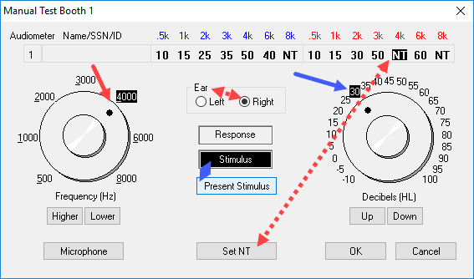
Audiometric Techniques and Considerations
Semi-Automatic Manual Mode (Student Practicum)
Tri-Service Hearing Technician 4.2 Certification Course
Notes:
Have student place headphones on BAS and manually test the right ear 4000 Hz; Select ear/frequency; set NT if thresholds are present
Present stimulus at 30 dB; increase by 20 dB then by 10 dB until patient responds, if using the semi automatic manual testing mode do not adjust dials once the patient responds
Bracketing method will initiate, application will keep track of the patient responses, once the patient responds twice in an ascending manner, threshold will lock

Slide 22
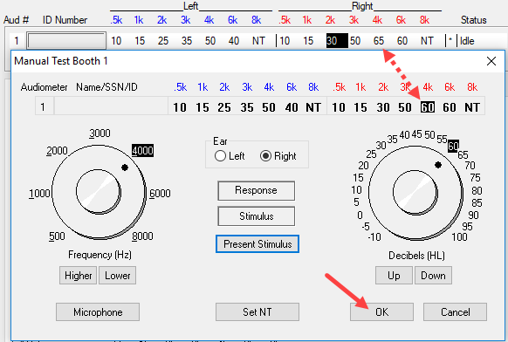
Audiometric Techniques and Considerations
Semi-Automatic Manual Mode (Student Practicum)
Tri-Service Hearing Technician 4.2 Certification Course
Notes:
Changes may be apparent when testing a patient and NT is not set.

Slide 23
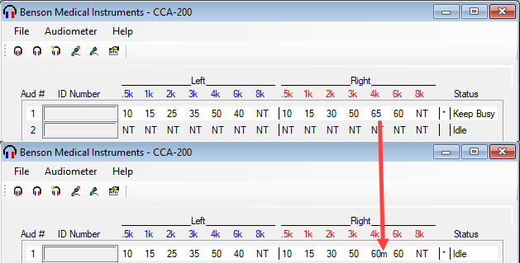
Audiometric Techniques and Considerations
Semi-Automatic Manual Mode (Student Practicum)
Tri-Service Hearing Technician 4.2 Certification Course
Notes:
“m” identifier will be present ONLY in the CCA-200 portion of the application

Slide 24
Audiometric Techniques and Considerations
Manual Testing (CCA-200)
  Select ear, frequency, set NT, present initial stimuli at 30 dB (default)
  Do not give visual cues, press present stimulus
  Increase by 20 dB then by 10 dB increments until patient responds
  Once patient responds, software will use the bracketing method (do not adjust dials after initial response if using the semi-automatic manual testing mode)
  Vary time interval between stimulus presentation to avoid a rhythmic tone presentation
  Lock thresholds when patient responds twice in an ascending manner (automatically done if using the semi-automatic manual testing mode)
Tri-Service Hearing Technician 4.2 Certification Course
Notes:
Do not adjust the frequency or decibel levels once a patient responds if using the semi-automatic manual testing mode, application will keep track of the responses/stimuli presented and lock in thresholds once the patient responds twice in an accenting manner.

Slide 25
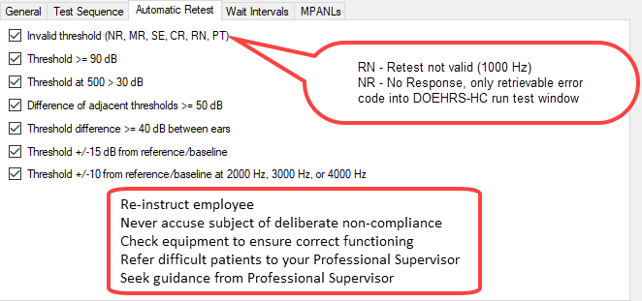
Audiometric Techniques and Considerations
CCA-200 Automatic Threshold Retest
Tri-Service Hearing Technician 4.2 Certification Course
Notes:
Review complete ear retest similarities

Slide 26
Audiometric Techniques and Considerations
Manual Testing (Common Issues)
Facial or visual cues
Rhythmic pattern of presenting stimuli
Earphones placement
Poor (sloppy, rushed, non-standard) instruction
Forgetting 1000 Hz retest
Recording data incorrectly in DOEHRS-HC (wrong ear or thresholds)
Tri-Service Hearing Technician 4.2 Certification Course

Slide 27
Audiometric Techniques and Considerations
Factors Affecting Test Validity
Poor test environment
Cross-over hearing (Masking) discussed in later classes
Uncooperative patients
Fatigue, sleepiness
Tinnitus
Manual coordination problems
Wax impaction, collapsing ear canals
Lack of understanding the audiometric instructions
Anxiety and claustrophobia
Tri-Service Hearing Technician 4.2 Certification Course

Slide 28
Audiometric Techniques and Considerations
Summary
Aural history
Patient test considerations
Testing preparation
Automated process for pure tone air conduction testing
Manual testing methods
Factors affecting test validity
When to do an otoscopic examination
Normal/Abnormal tympanic membrane
Tri-Service Hearing Technician 4.2.0.0 Certification Course

Slide 29
Audiometric Techniques and Considerations
? Questions ?
Tri-Service Hearing Technician
4.2 Certification Course

